Slide 1
Artificial Human Organs & Selling of Human Organs
Hassan Alatawa
Binti Mohamed

Slide 2
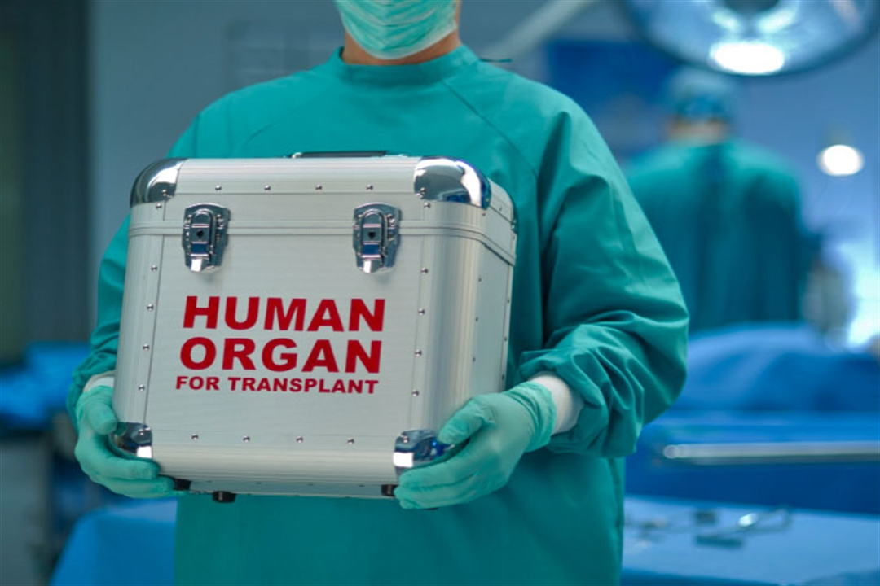
Transplants
A transplant is a surgical procedure where a healthy organ from a donor is placed into another body. Organ transplantation is relatively old and established procedure.

Slide 3
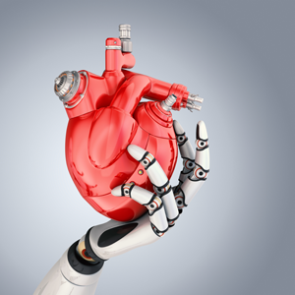
What are Artificial organs?
-Artificial organs is any machine, device,or other material that is used to replace the functions of a faulty or missing organ or other part of the human body.
-An artificial organ is an engineered device that is implanted or integrated into a human.
-It interfaces with living tissue
-Its job is to replace natural organ or duplicate a specific function to help humans return to normal life as soon as possible
-The Replace function does not have to be related to life support, but it often is. For example, replacement of bones and joints, such as those found in hip replacements,could also be considered as artificial organs

Slide 4
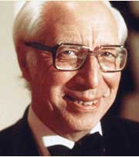
History behind artificial organs. Who was the first to create them?
-Doctor Willem Kolff was the father of Artificial organs. He invented the first Artificial kidney( blood dialysis) machine, pioneered blood transfusion in Europe. Invented The Heart-Lung machine.
-Kolff was born in the Netherlands, in 1911.
-Despite having dyslexia, he studied medicine in his hometown Lieden, where he worked as a pathology assistant before graduating in 1938.
-Lived during WW2

Slide 5
More on Doctor Willem Kolff
In 1943 he developed a kidney machine after experiments using blood contained in commercial sausage-skin – which allows minerals to diffuse through it
which allows minerals to diffuse through it – immersed in a bath of salts
He wrote: "I found that in five minutes nearly all the urea I had added to the blood sample, 400 milligrams of it, had disappeared from the blood and had entered the saline bath."
Fourteen of the first 15 patients on whom he used the technique died, The first patient whose life Kolff undoubtedly saved was a 67-year-old woman, Maria Sofia Schafstadt, who had been imprisoned as a Nazi collaborator. She lived for a further seven years.

Slide 6
Selling of human organs
First & foremost : Can I Sell an Organ? Although the high demand for organs creates an opportunity for those willing to sell a spare kidney, the lobe of a lung, or even the organs of the deceased. However, it is strictly illegal to sell an organ, in accordance with federal law.
First case of organ trafficking in the U.S. : Levy Izhak Rosenbaum called himself a "matchmaker," but his business wasn't romance. Instead, authorities say, he brokered the sale of black-market kidneys, buying organs from vulnerable people from Israel for $10,000 and selling them to desperate patients in the U.S. for as much as $160,000.

Slide 7
Only country that allows the legal selling of human organs?
-Iran
Iran is the only nation that allows organs to be bought and sold legally. However, it does place restrictions on the commercial organ trade in an attempt to limit transplant tourism.
-Foreigners are not allowed to buy the organs of Iranian citizens. Additionally, organs can only be transplanted between people of the same nationality. So, for example, an Iranian cannot purchase a kidney from a refugee from another country. The system is largely charity and volunteer-based, and those tasked with matching donors and patients are not paid for their work.

Slide 8
Pros for the selling of Human organs
-Will cut the amount of time patients wait for an organ donor
-People selling organs may be at a time in need so selling for $5,000-$20,000 an organ may really help them financially

Slide 9
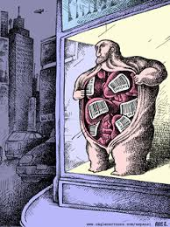
Cons for selling human organs
-The poor will be exploited
-Possibility that the donors health may be affected

Slide 10
Pros for Artificial Organs
Reduce and one day replace the need of donors:
Reduce people getting trafficked for their organs
A stopgap

Slide 11
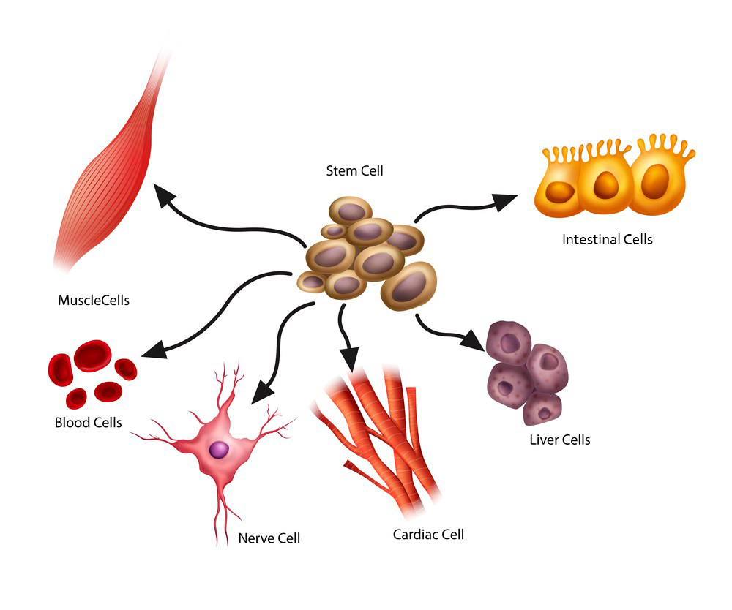
Cons for Artificial Organs
Already infected
Cost
Organ Failure
Stem Cells?

Slide 12
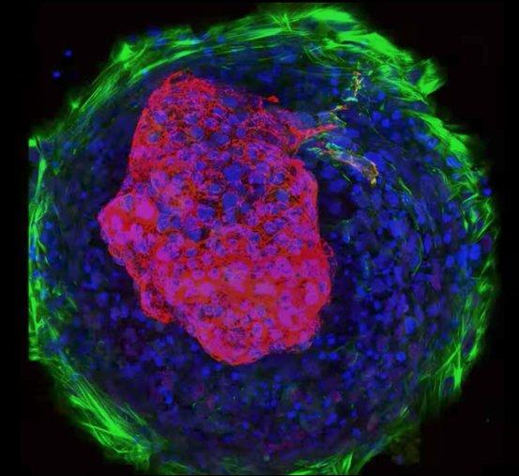
Future of Artificial organs
3D-Bioprinting
Use to test drugs

Slide 13
Sources
https://www.livescience.com/59675-body-parts-grown-in-lab.html
https://futurism.com/artificial-organs-entering-era-transplants-obsolete/
http://syntheticorgans.yolasite.com/legal-and-ethucal-issues.php
https://prezi.com/ujelpfbdbe5u/procon-selling-organs/
https://www.intelligencesquaredus.org/briefing-room/we-should-legalize-market-human-organs

